Slide 1




HackOrbit 2025
Team Name: 404 NOT FOUND

Slide 2

THEME & PROBLEM STATEMENT
In the tourism industry, collecting, managing, and analyzing customer feedback is a crucial yet often overlooked aspect of service improvement. Many tour operators rely on outdated or manual methods to gather feedback, which results in lost insights, data inconsistencies, and poor customer engagement. Additionally, without a secure platform, sensitive customer data is at risk, and administrators lack real-time access to feedback for timely decision-making. There is a pressing need for a robust, scalable, and secure digital system that not only simplifies the feedback collection process for users but also provides an intuitive admin interface to manage and evaluate feedback efficiently.

Slide 3
PROPOSED SOLUTION
Our solution is a full-stack tour feedback system that:
Collects feedback through a responsive frontend form.
Validates and stores feedback using Node.js and PostgreSQL.
Offers a secure admin panel with login, dashboard, and session management.
Implements SQL injection protection and responsive design.

Slide 4
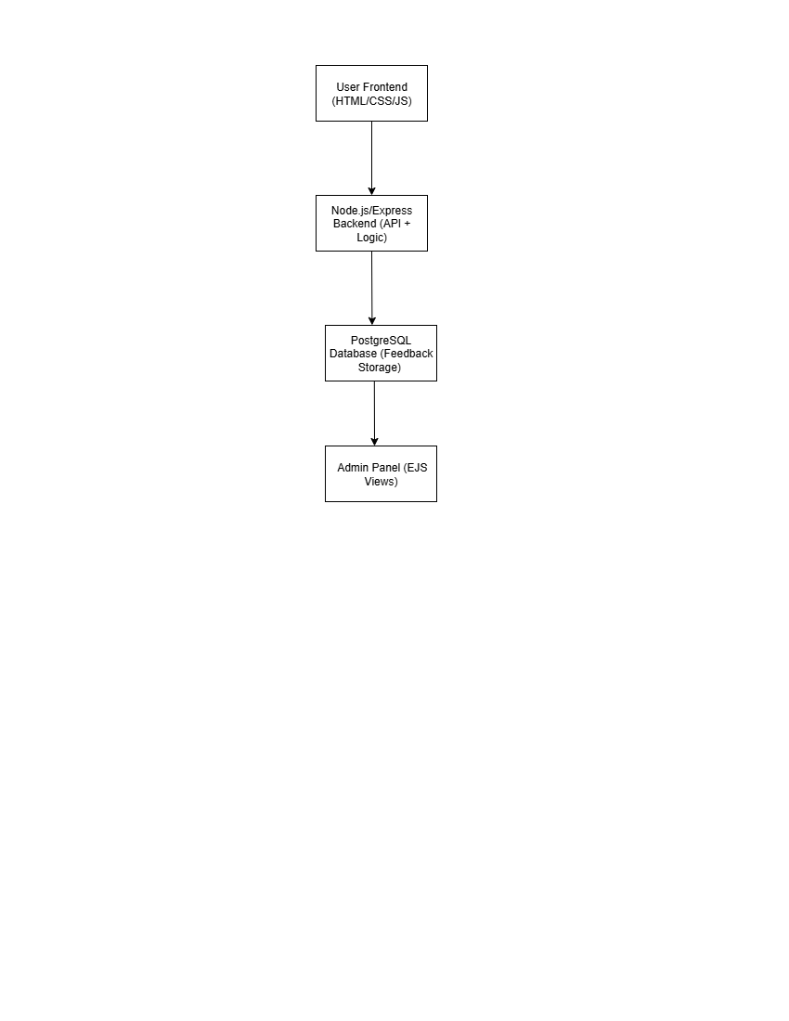
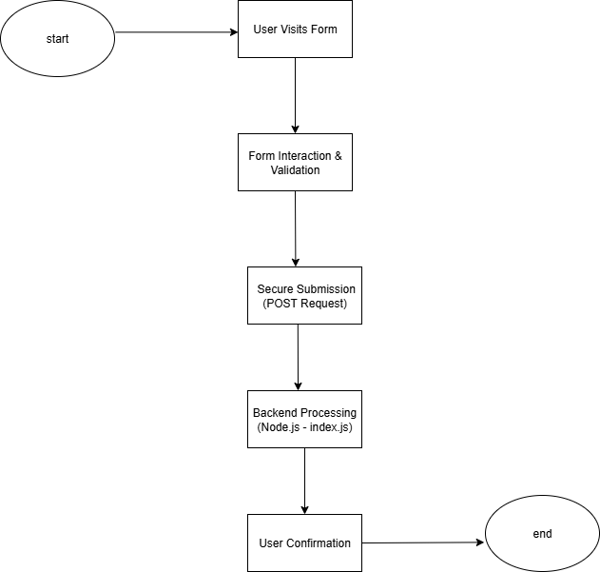
FLOWCHART / DIAGRAM

Slide 5
FLOWCHART / DIAGRAM
Flow Description:
User Frontend → Visitors submit feedback via a form.
Backend (Node.js/Express) → Receives feedback, validates it, and stores it securely.
PostgreSQL DB → Stores the feedback reliably.
Admin Panel (EJS) → Admins view/manage feedback retrieved from the database.
Step | Description
1 | User accesses the form via http://localhost:5000 → loads public/index.html
2 | User enters name, email, rating, package, comment → JS validates it
3 | On "Submit", POST request is sent to backend
4 | index.js (Node.js) validates and stores the data in PostgreSQL DB
5 | Success message confirms feedback received

Slide 6
FEATURES AND NOVELTY
Responsive frontend with Tailwind CSS.
Secure backend using Express.js and PostgreSQL.
Admin login with session management.
SQL injection protection via parameterized queries.
Scalable architecture & modular codebase.
Admin dashboard with feedback viewing and login-logout.

Slide 7
DRAWBACK AND SHOWSTOPPERS
Admin credentials are hardcoded (currently).
In-memory session storage (not persistent).
No email alerts or advanced analytics (future enhancement).
No role-based access control.

Slide 8
TEAM NAME: 404 NOT FOUND
TANMAY GUHA - 6296808190 - tanmayguha15@gmail.com
MAYUKH DAS – 7001998228 – mayukhkng@gmail.com
LIPSA POREL – 8391983145 – porellipsa7@gmail.com
SNEHA KUNDU – 7605873432 – snehakundu980@gmail.com

Slide 9
Thank you

